Slide 1


MSc in Microbiome in Health and Disease
M2: Transcriptomics
(https://github.com/FrederickClasen/KCL_MSc_2023)
Frederick Clasen
(frederick.1.clasen@kcl.ac.uk)

Slide 2
Agenda for the lecture + workshop
# | Time | Agenda
1 | 12:00 – 13:00 | Seminar of transcriptomics history and overview of techniques Overview of tools used and new generation pipelines Introduction to Nextflow (just slides no coding)
2 | 13:00-14:00 | Break
4 | 14:00-16:00 | Live demonstration of RNA-sequencing analysis. Scripts will be available on KEATS (no need to do it live)
In depth RNA-sequencing tutorial:
https://scienceparkstudygroup.github.io/rna-seq-lesson/

Slide 3
Introduction to the theory and practice of RNA-sequencing analysis
Learning objectives:
Describe the rationale for sequencing RNA
Discuss the challenges specific to RNA-sequencing
Describe the general goals and themes of RNA-sequencing analysis workflows
Understand the common technical challenges in RNA-sequencing
In depth RNA-sequencing tutorial:
https://scienceparkstudygroup.github.io/rna-seq-lesson/

Slide 4
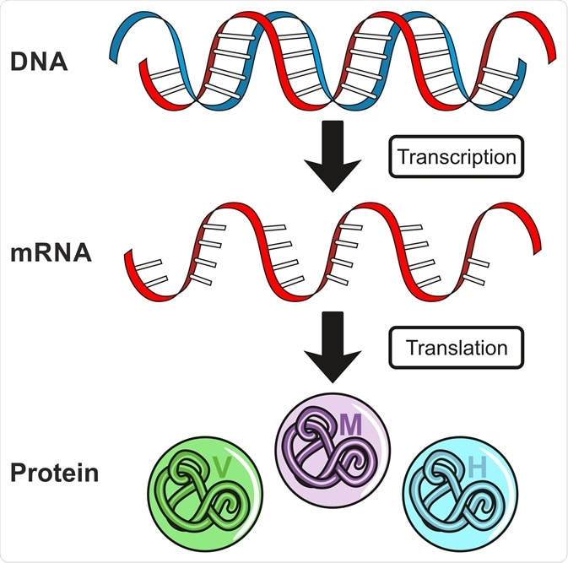
What is gene expression?
All genetic information of an organism or cell is kept in its DNA as genes
However, proteins are the “workhorses” of biology and perform necessary molecular functions for a cell, tissue or organism to function, grow and survive
The central dogma in biology describes that DNA is transcribed to messenger-RNA (mRNA) which is then translated into proteins that perform these functions
The transcription of genes from DNA to mRNA is referred to as gene-expression

Slide 5
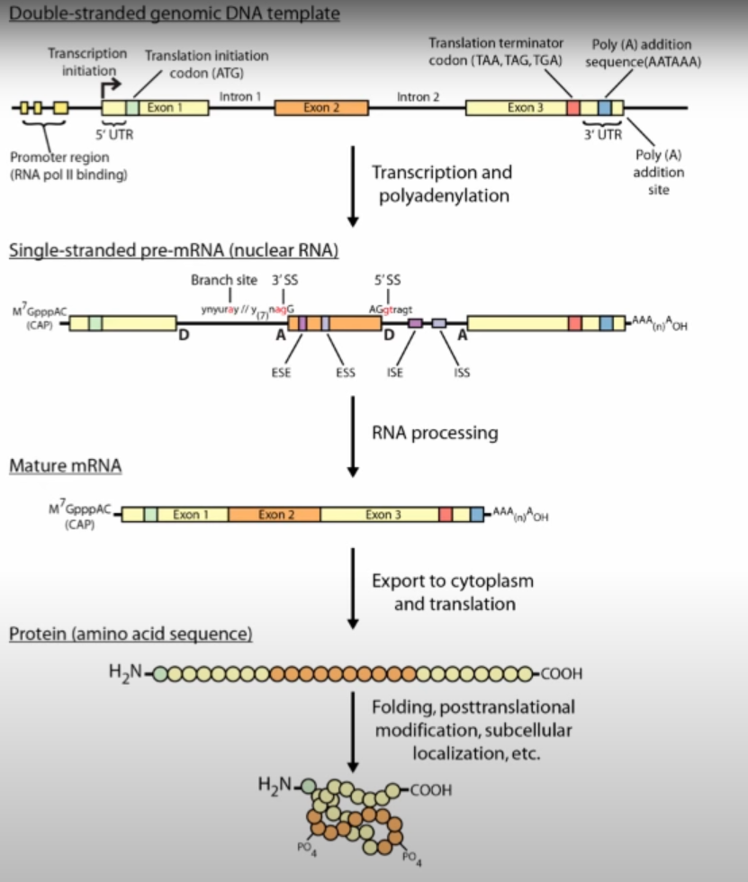
What is gene expression?
All genetic information of an organism or cell is kept in its DNA as genes
However, proteins are the “workhorses” of biology and perform necessary molecular functions for a cell, tissue or organism to function, grow and survive
The central dogma in biology describes that DNA is transcribed to messenger-RNA (mRNA) which is then translated into proteins that perform these functions
The transcription of genes from DNA to mRNA is referred to as gene-expression
Gene expression is a highly regulated and precise biological process that depends on several factors, cell type and cellular localization

Slide 6
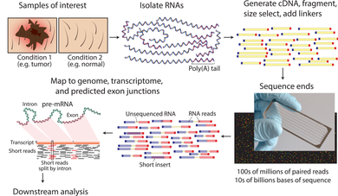
What is RNA-sequencing?
RNA-sequencing is a sequencing technique that uses next-generation sequencing to reveal the presence and quantity of RNA in a biological sample.
Performing RNA-sequencing will tell you how much each gene is expressed under a particular condition
An RNA-sequencing has a wet-lab facet as well as a computational facet
Wet-lab involves the isolation of RNA from a sample of interest,, fragmenting RNA into short segments, ligating sequencing adapters and amplification which is then sequenced
The computational side involves the mapping of sequencing reads to a reference genome to quantify transcripts and then performing further statistical analysis to “makes sense” of this data

Slide 7
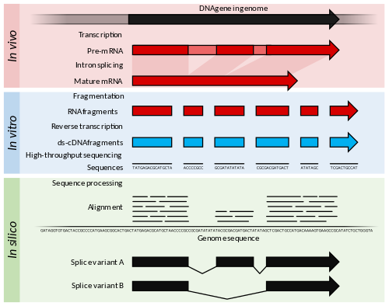
Why sequence RNA (versus DNA)?
INFORMATION!!!
Functional studies
The genome is constant but specific conditions has a pronounced effect on gene expression.
For example, the genome of a liver cell in a fed-state versus a fasted-state are the same, but its gene expression is vastly different
Similar, drug-treated versus untreated cell lines
Wild-type versus knock-out mice
Predicting the genetic sequence of transcripts from the genome is difficult
Some molecular features can only be observed at RNA level – alternative isoforms etc

Slide 8
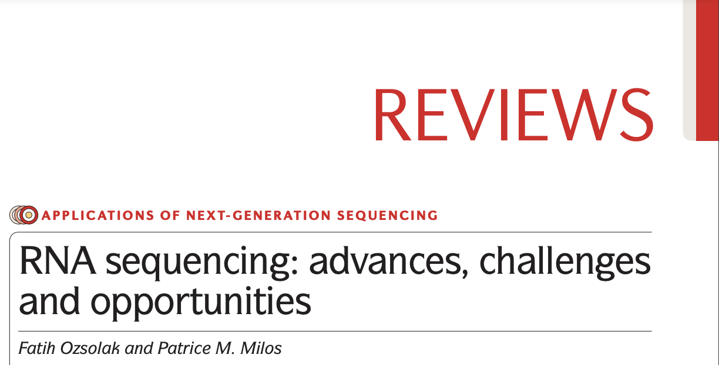
Challenges in RNA-sequencing
Experimental
Extraction purity, quantity and quality
RNA is fragile compared to DNA and is easily degraded
Different methods have been developed that are routinely used
Computational
Mapping reads to a genome is challenging because RNAs consists of small exons that may be separated by large introns
The relative abundances of RNAs vary widely
RNAs come in different sizes
Despite these challenges, RNA-sequencing are now performed routinely and the most widely used and cost-effective omics

Slide 9
An RNA-sequencing workflow
Stage 1: Pre-processing
Stage 2: Genome alignment & Quantification
Stage 3: Final QC
Stage 4: Post-processing / downstream analysis / interpretation

Slide 10
From raw reads to gene counts
The computational tools/software that has been built for RNA-sequencing is a lot more advanced, standardized and maintained compared to metagenomics
Stage 1: Pre-processing
Stage 2: Genome alignment & Quantification
Stage 3: Final QC

Slide 11
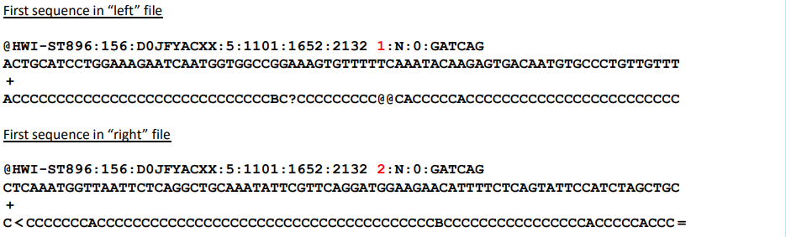
From raw reads to gene counts
Stage 1: Pre-processing
Goal is to investigate the quality of raw reads before performing any analysis
Stage 1: Pre-processing
Stage 2: Genome alignment & Quantification
Stage 3: Final QC

Slide 12
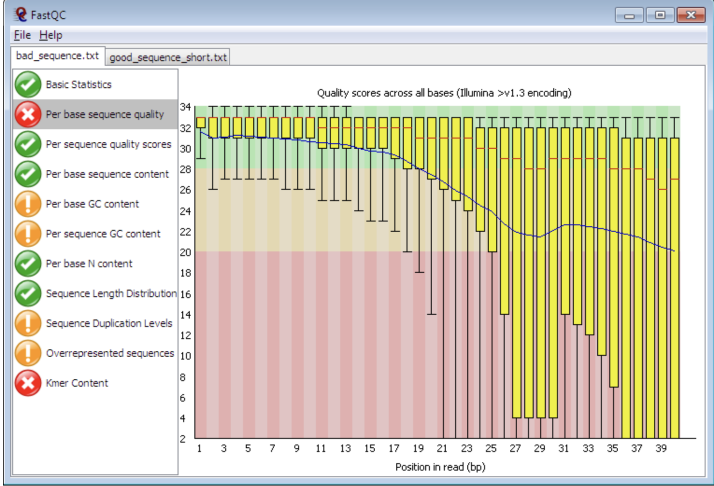
From raw reads to gene counts
Stage 1: Pre-processing
Gives quality scores for raw sequencing reads that help to either keep or discard samples depending on sequencing quality
Stage 1: Pre-processing
Stage 2: Genome alignment & Quantification
Stage 3: Final QC

Slide 13
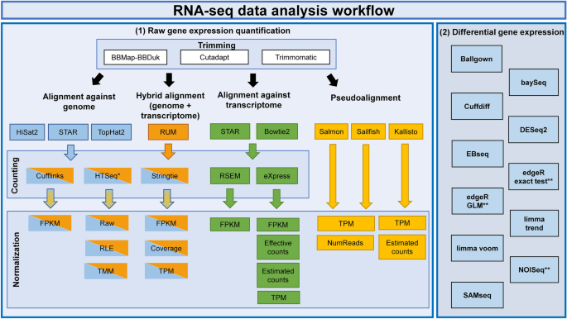
From raw reads to gene counts
Stage 2: Genome alignment and quantification
The purpose of alignment and quantification is to “count” the number of reads that map (i.e. align) to each gene using computational tools and statistics
Stage 1: Pre-processing
Stage 2: Genome alignment & Quantification
Stage 3: Final QC
Corchete et al., Scientific Reports, 2020

Slide 14
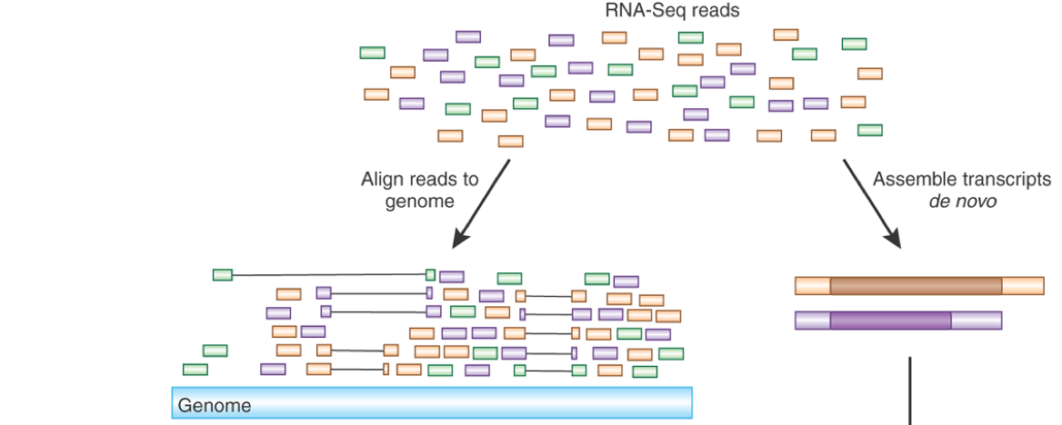
From raw reads to gene counts
Stage 2: Genome alignment and quantification
The purpose of alignment and quantification is to “count” the number of reads that map (i.e. align) to each gene using computational tools and statistics
Pseudoalignment is a fast and memory efficient way to narrow the space of possible references from which a query read may have originated
The software and methodology used do impact the results but not as much as in, for example, metagenomics. This is especially the case for well-curated genomes such as human or mouse
Stage 1: Pre-processing
Stage 2: Genome alignment & Quantification
Stage 3: Final QC

Slide 15
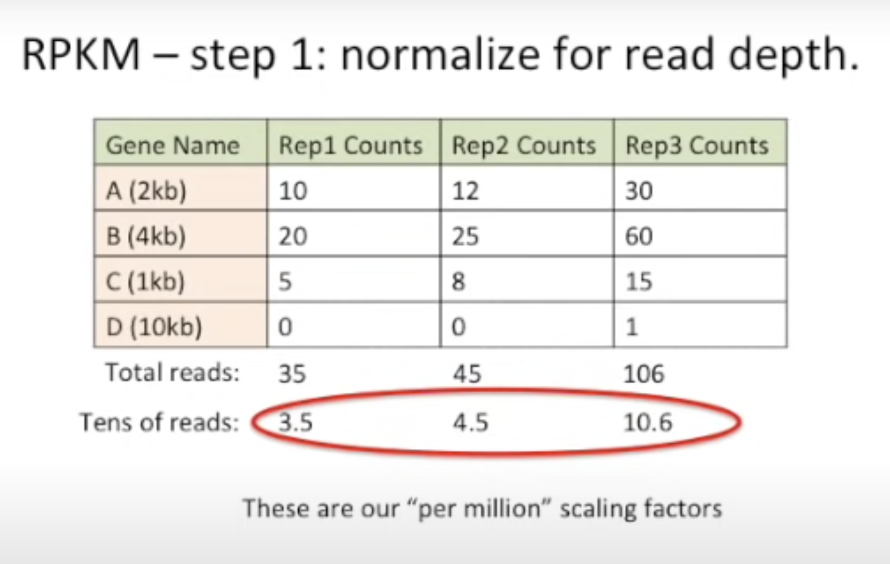
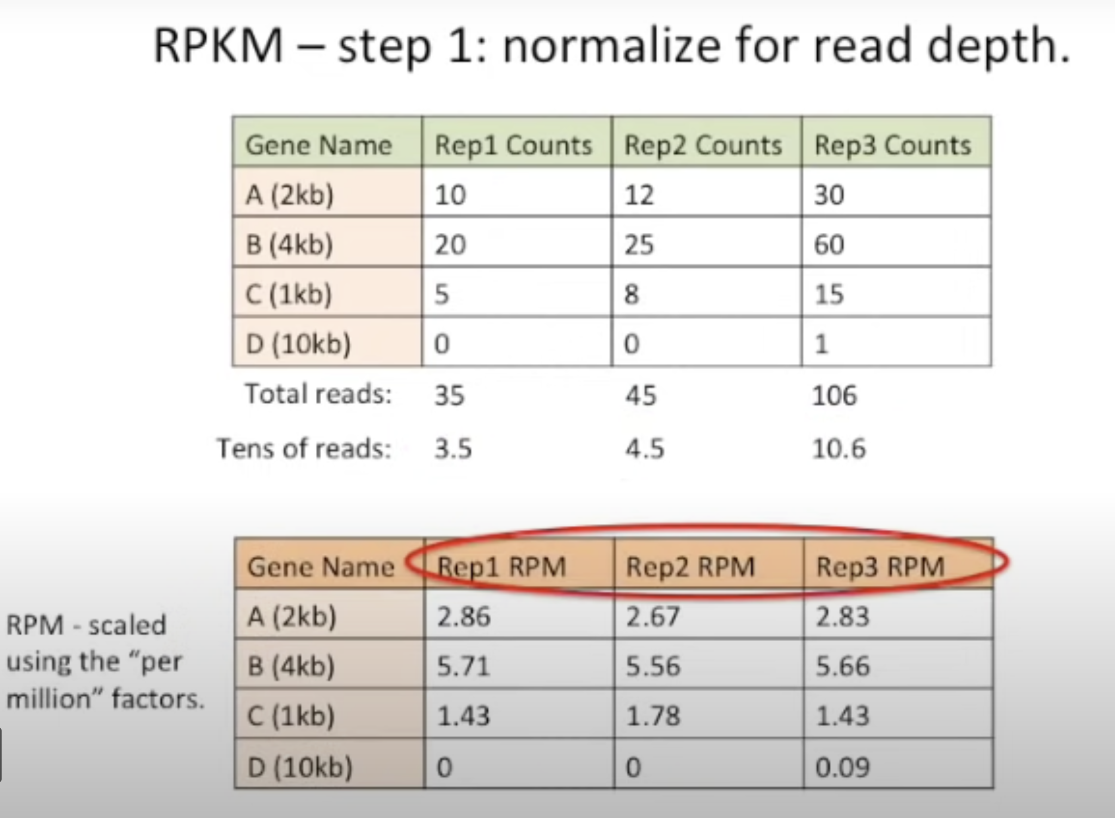
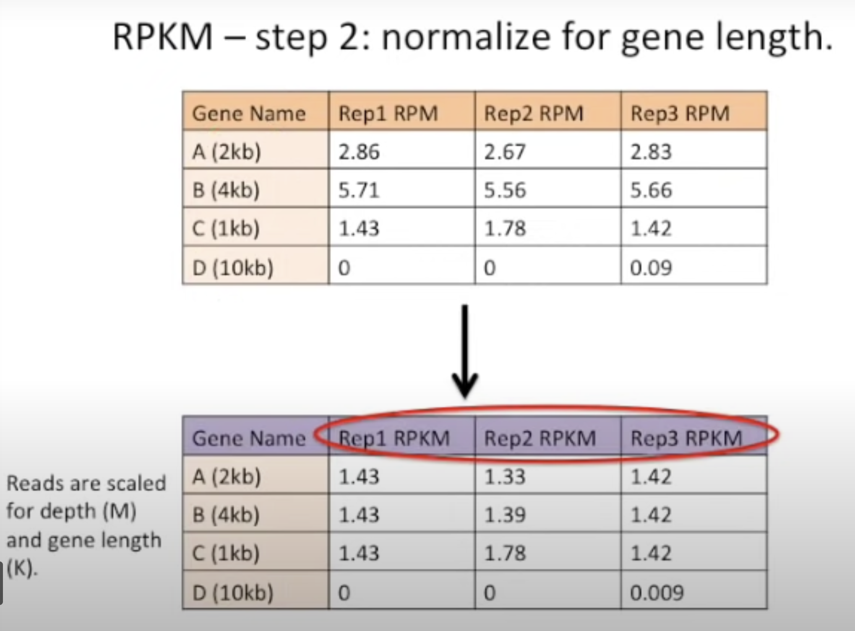
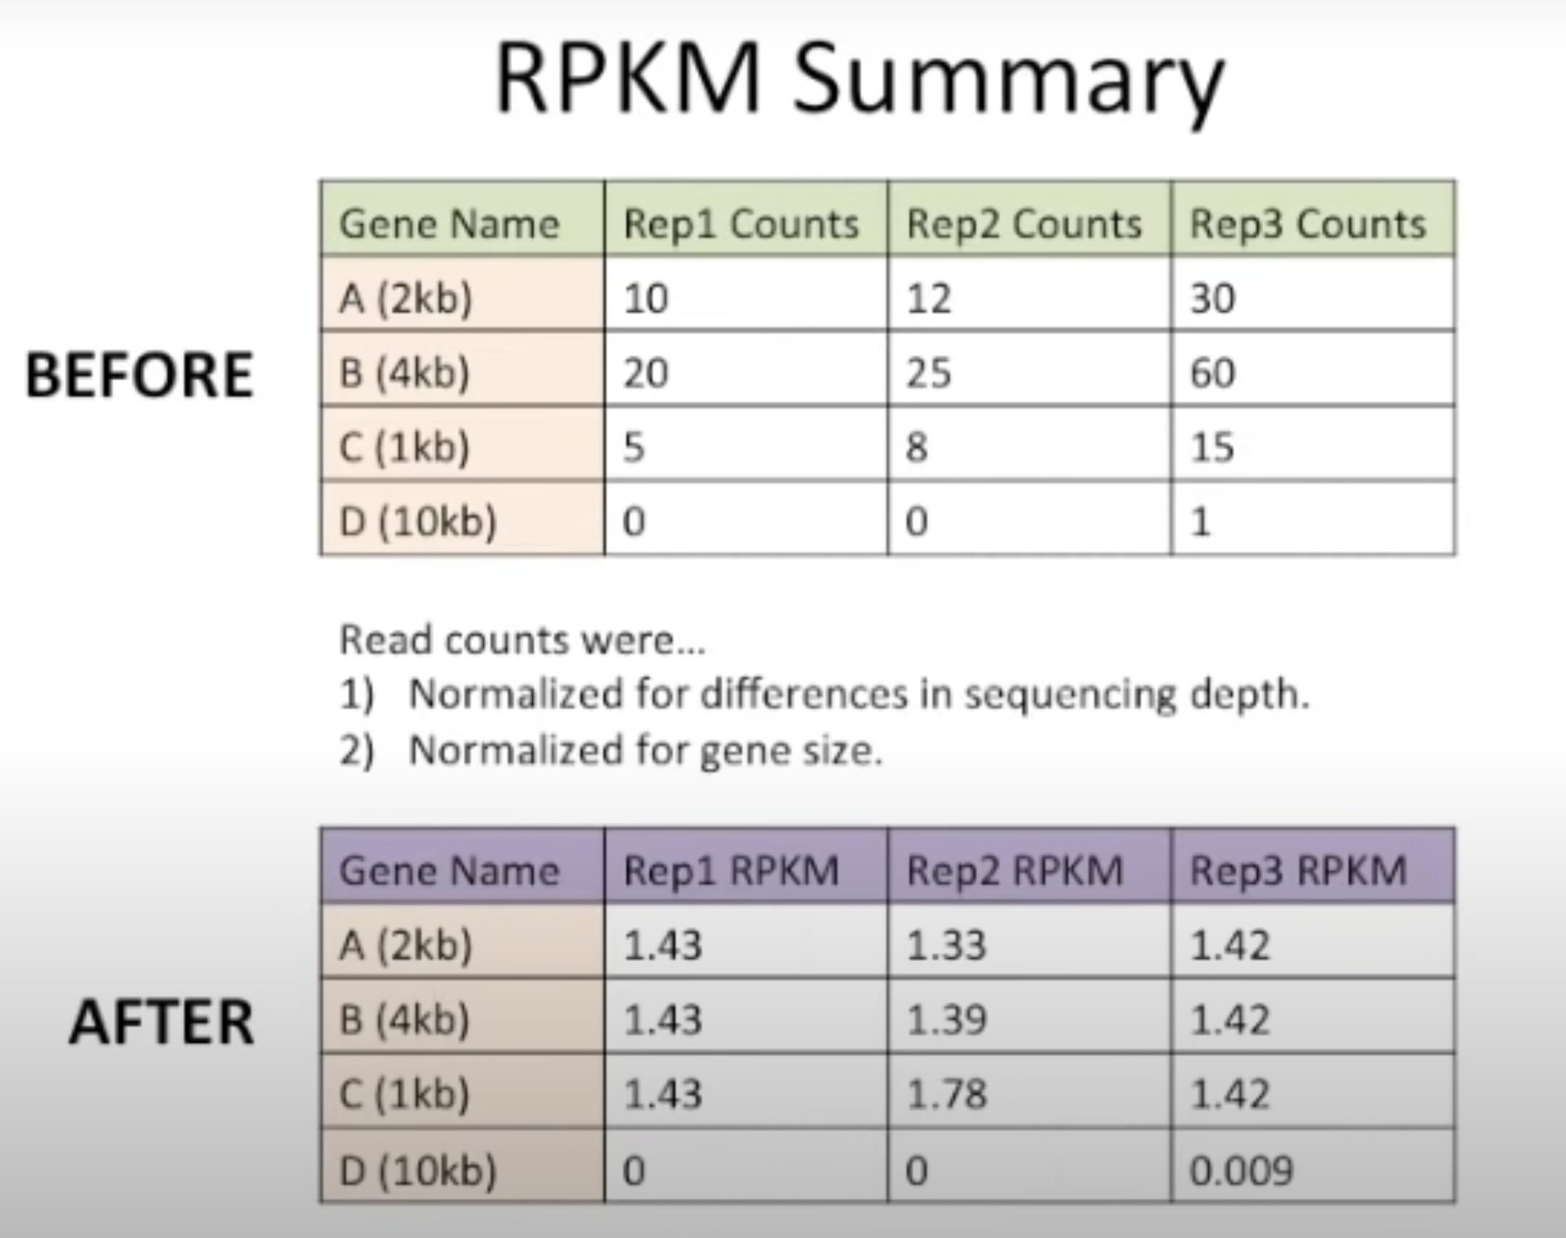
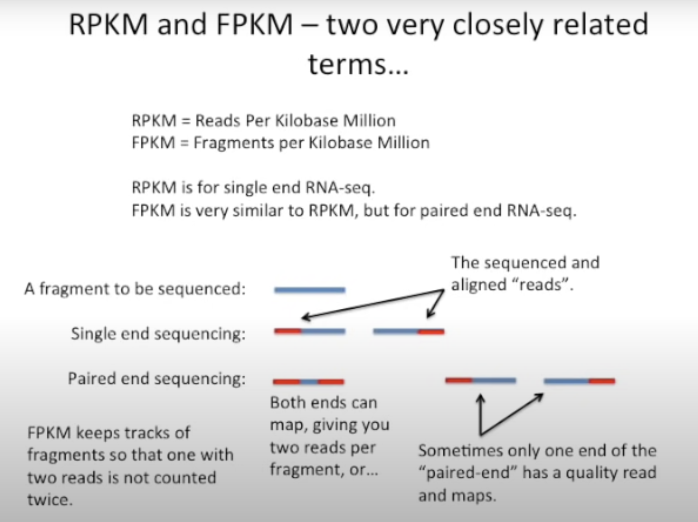
From raw reads to gene counts
Stage 3: Genome alignment and quantification
RPKM, FPKM and TPM
Stage 1: Pre-processing
Stage 2: Genome alignment & Quantification
Stage 3: Final QC

Slide 16
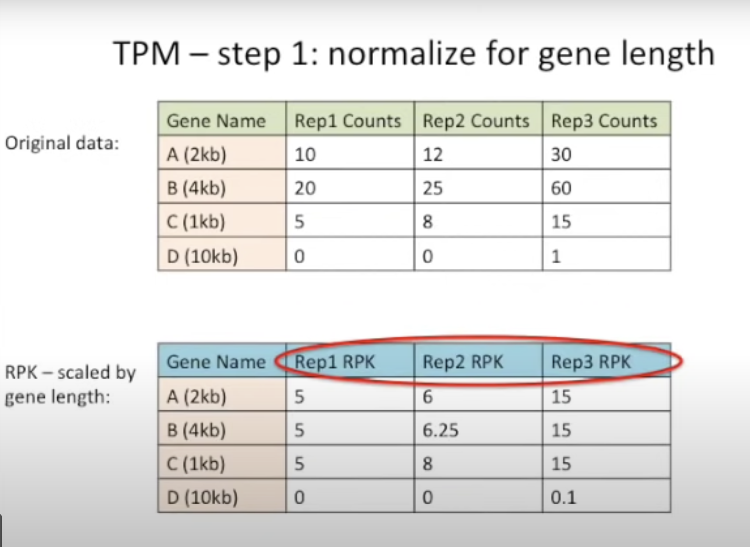
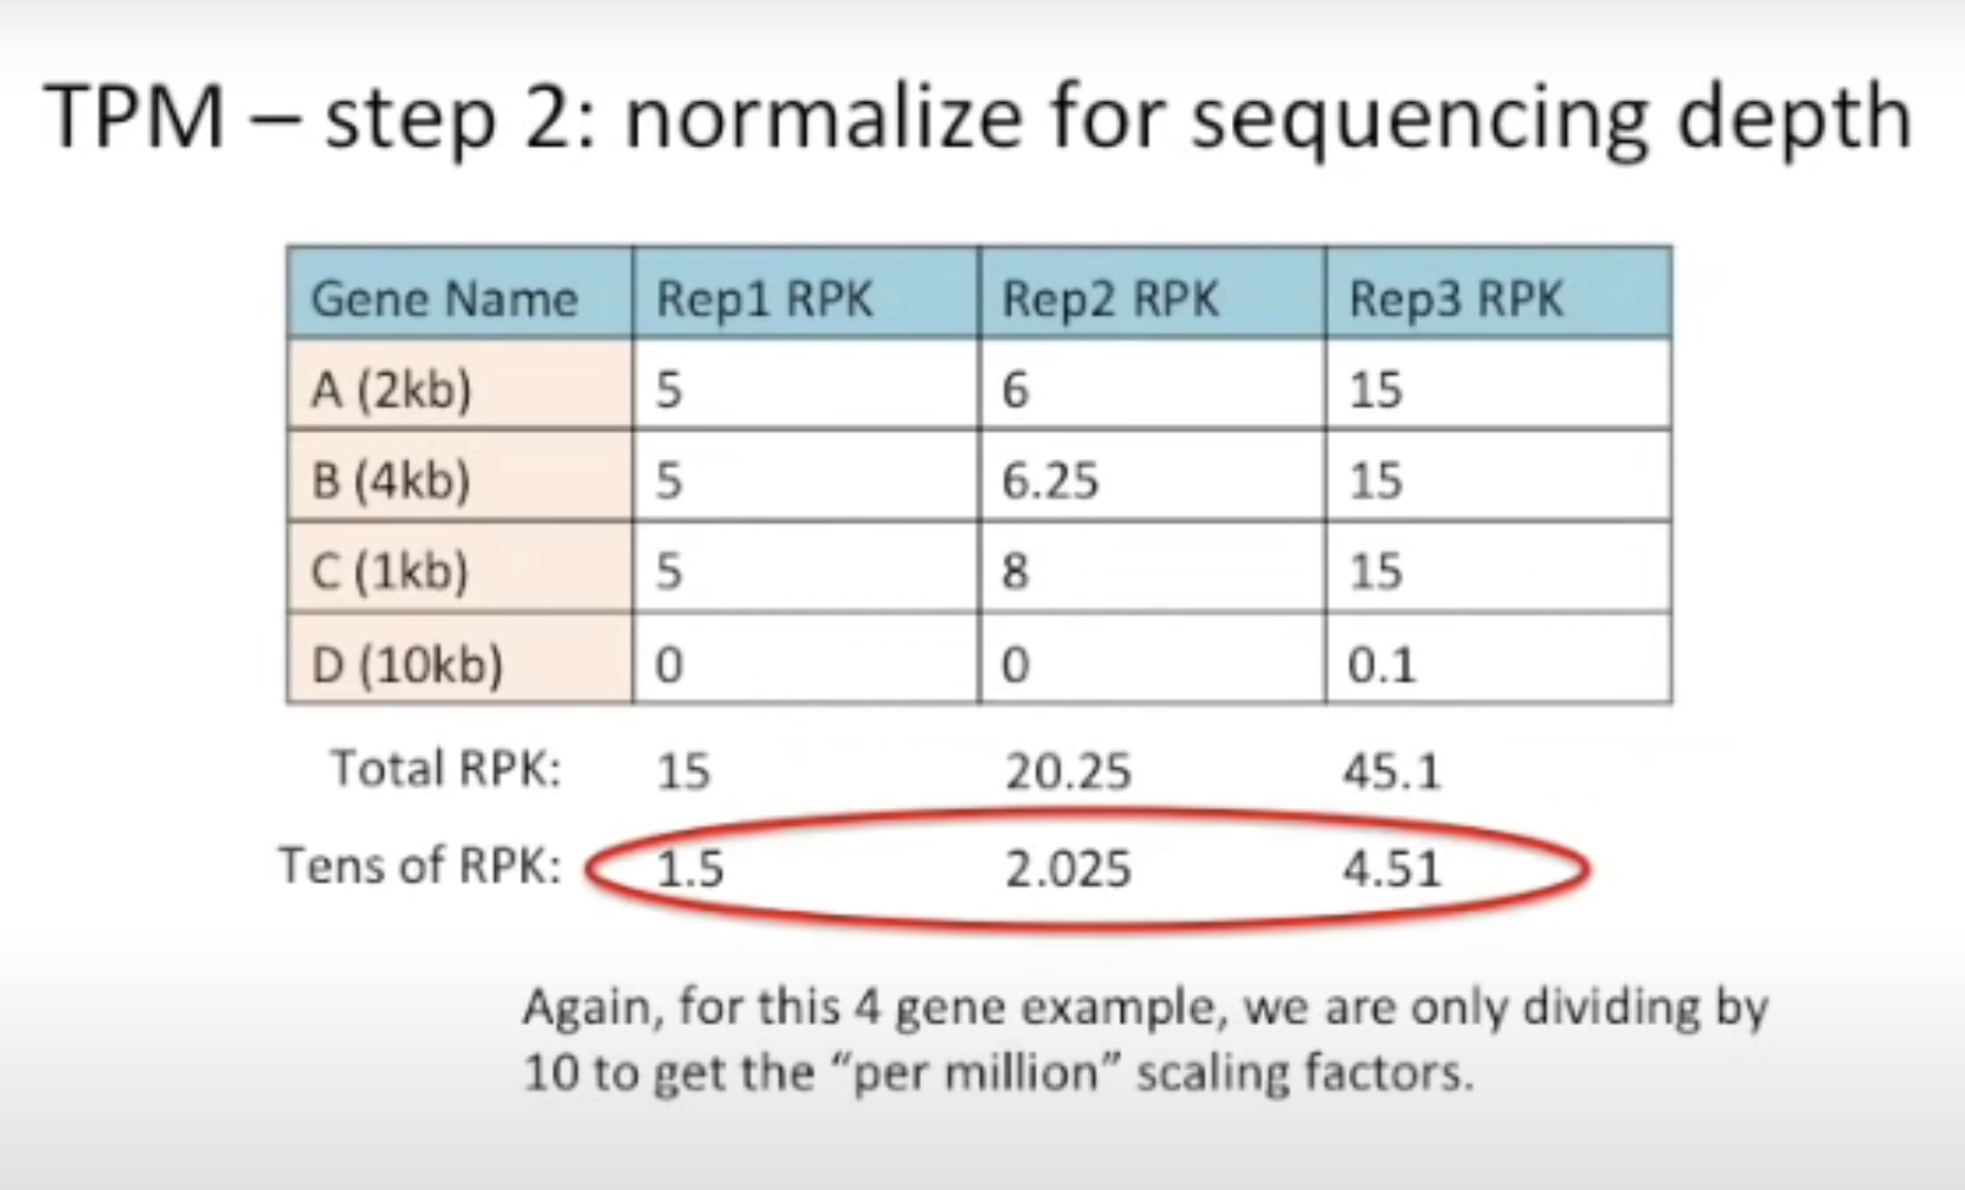
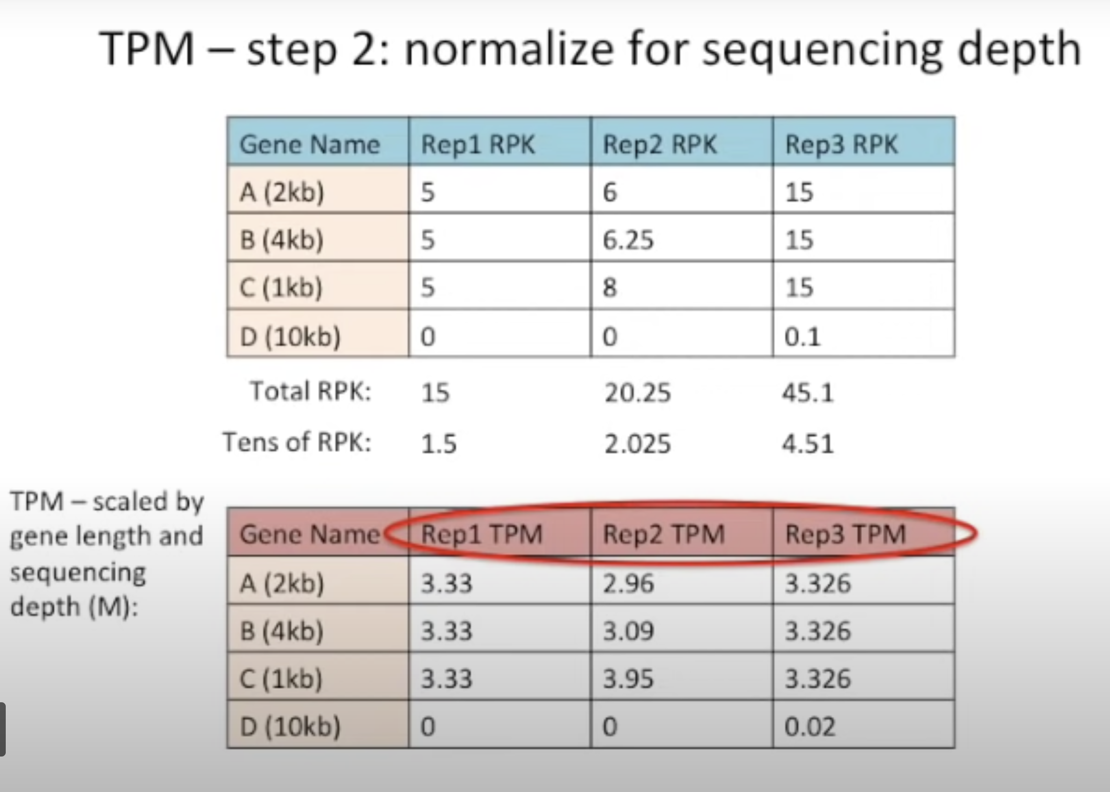
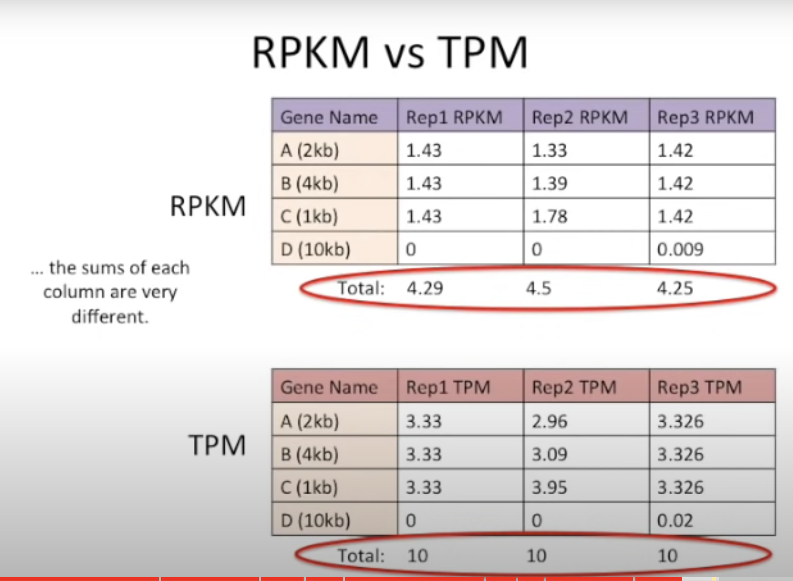
From raw reads to gene counts
Stage 3: Genome alignment and quantification
RPKM, FPKM and TPM
Stage 1: Pre-processing
Stage 2: Genome alignment & Quantification
Stage 3: Final QC

Slide 17
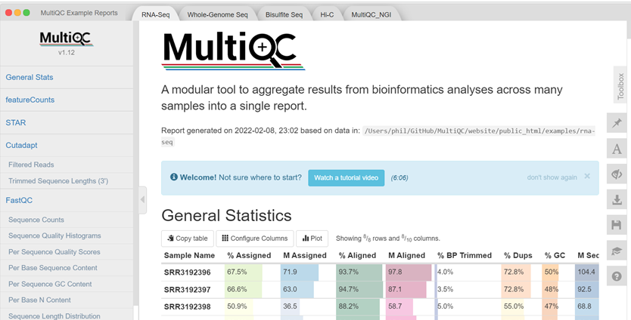

From raw reads to gene counts
Stage 3: Final QC
Stage 1: Pre-processing
Stage 2: Genome alignment & Quantification
Stage 3: Final QC
https://github.com/ewels/MultiQC

Slide 18
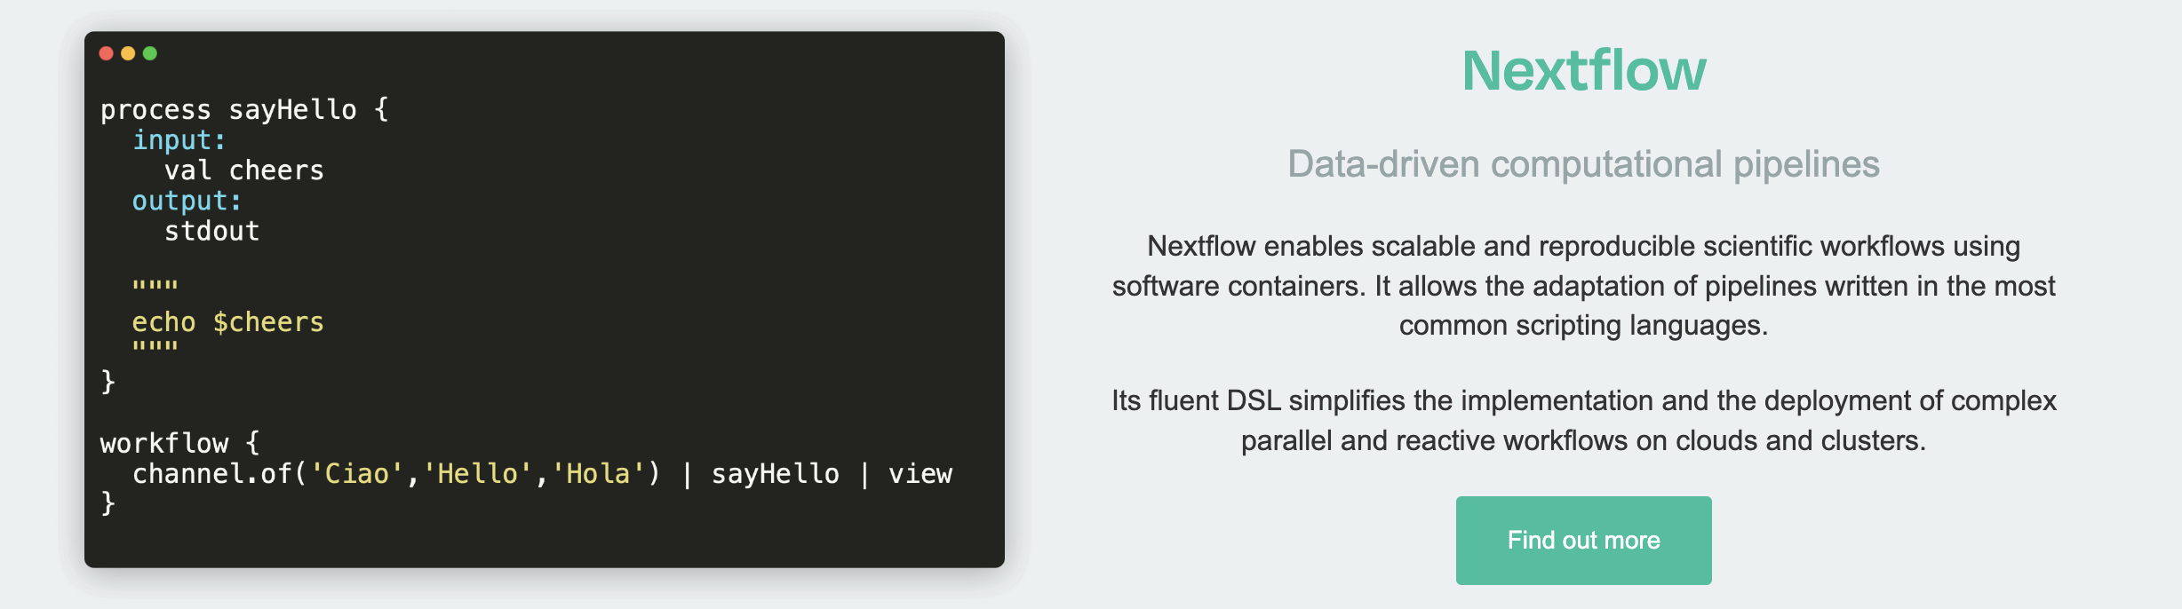

Introduction to Nextflow
The analysis of omics data are routinely taking place with the same “pipelines” being used again and again to process data from raw data to data types with meaning that can be interpreted
Nextflow was first released in 2013 as a domain-specific language (DSL) to manage scientific workflows based on Groovy and Java

Slide 19
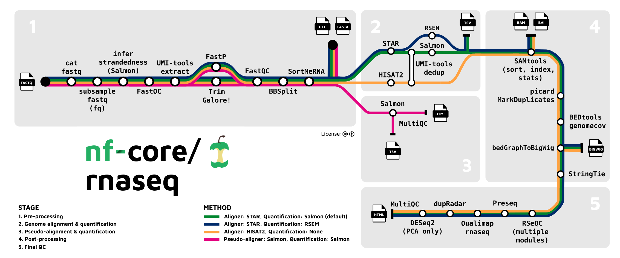
Introduction to Nextflow
Latest nf-core RNA-seq pipeline: https://nf-co.re/rnaseq/3.12.0

Slide 20
You have gene counts
…
What now?
How do we interpret gene count data?
How do we know if a gene is changing in expression?
Are there any specific groups of genes that change?
What does it tell us about the biology?

Slide 21

Data interpretation
”downstream analysis”
The most common RNA-sequencing interpretation workflows are:
Differential gene expression
Which genes are STATISTICALLY dysregulated compared to another condition
For example, what genes are increased / decreased in expression in a KO versus a WT cell
This forms the basis of several other analyses
Gene set enrichment analysis
Identifies whether a certain pre-defined set of genes (such as pathways, or biological process) are dysregulated
Quite often based on differential gene expression analysis
Data integration
Genome-scale metabolic models
Gene co-expression
Network analysis

Slide 22
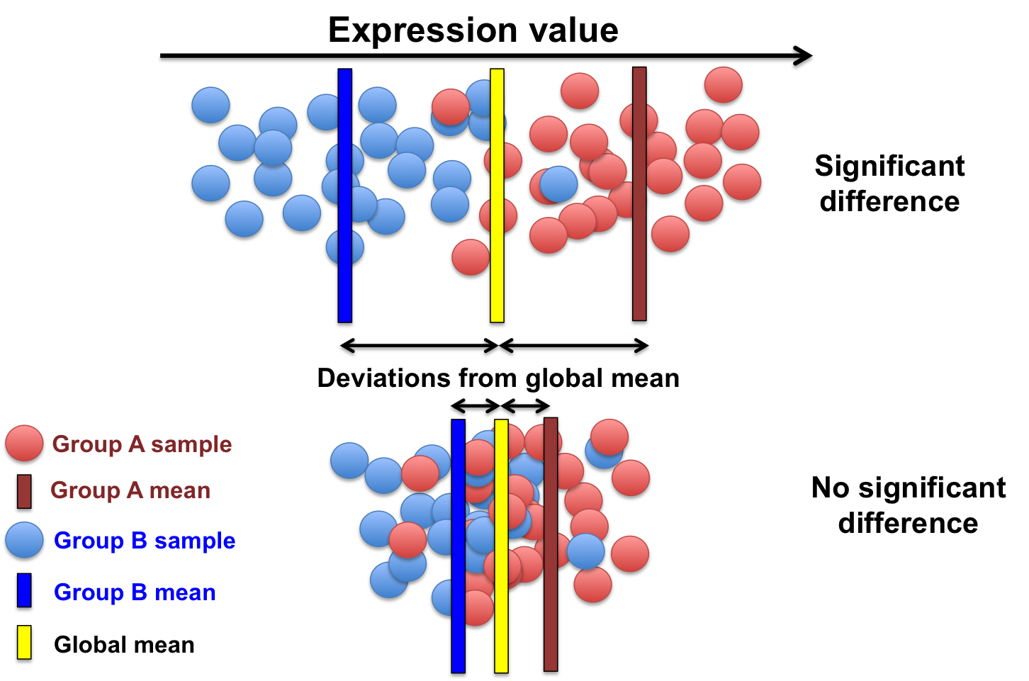
Differential gene expression analysis

Slide 23
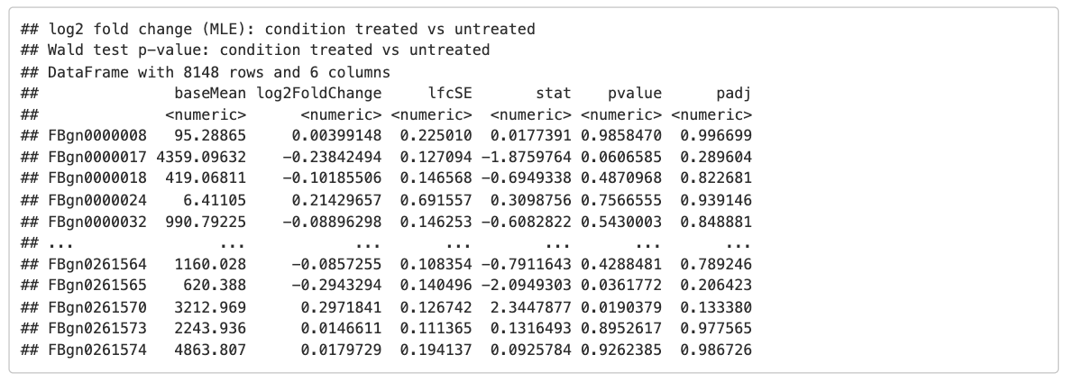
Differential gene expression analysis
There are several software packages available to perform differential gene expression
DESeq2 – the most widely used and versatile package
EdgeR
Limma – does well with time-series data
Ballgown
The following resources are essential to understand DESeq2:
https://bioconductor.org/packages/devel/bioc/vignettes/DESeq2/inst/doc/DESeq2.html
https://genomebiology.biomedcentral.com/articles/10.1186/s13059-014-0550-8
DESeq2 takes unnormalized counts from most commonly used genome quantification tools such as kallisto, salmon, RSEM etc and then fits a generalized linear model for each gene to identify genes that are significantly changing
The output of performing a DESeq2 experiment

Slide 24
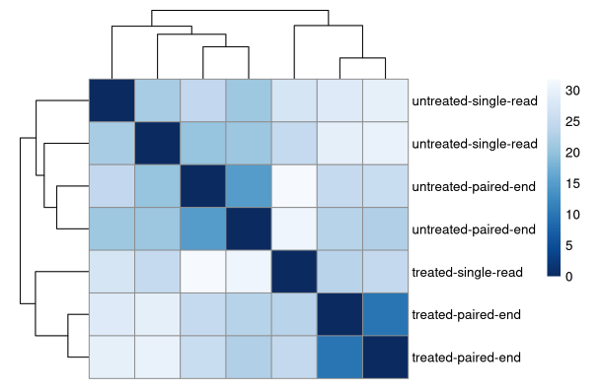
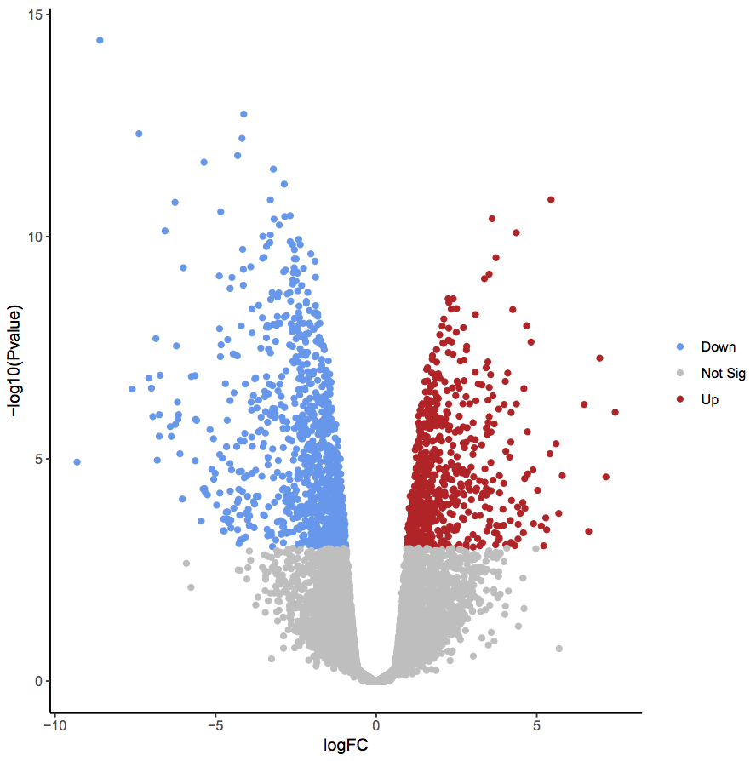
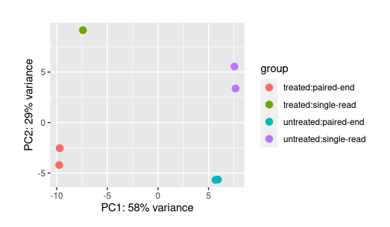
Differential gene expression analysis
Volcano plot – shows differential expression of each gene for a single comparison
Distance matrix – how close each sample is to each other
Principal component analysis – clustering of samples based on their variance

Slide 25
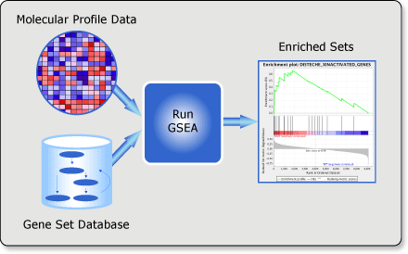
Gene set enrichment analysis
Gene set enrichment analysis (GSEA), sometime also called functional enrichment analysis or pathway enrichment analysis, is a method to identify classes of genes that are over-represented in a larger set of measured genes that may have an association to a specific biological phenotype

Slide 26
Gene set enrichment analysis
Gene set enrichment analysis (GSEA), sometime also called functional enrichment analysis or pathway enrichment analysis, is a method to identify classes of genes that are over-represented in a larger set of measured genes that may have an association to a specific biological phenotype
Defining the specific gene set is the core step in this process. Widely used pre-defined set are:
Gene ontology (biological processes, molecular functions and cellular component)
This is a very important concept in molecular biology in general
https://geneontology.org/
https://www.gsea-msigdb.org/gsea/msigdb/human/collections.jsp
KEGG pathways
Hallmark gene sets
https://www.gsea-msigdb.org/gsea/msigdb/human/collections.jsp
Specific cancer pathways

Slide 27
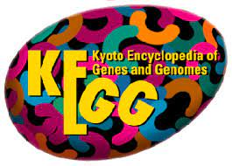

Gene set enrichment analysis
Gene set enrichment analysis (GSEA), sometime also called functional enrichment analysis or pathway enrichment analysis, is a method to identify classes of genes that are over-represented in a larger set of measured genes that may have an association to a specific biological phenotype
Defining the specific gene set is the core step in this process. Widely used pre-defined set are:
Gene ontology (biological processes, molecular functions and cellular component)
This is a very important concept in molecular biology in general
https://geneontology.org/
https://www.gsea-msigdb.org/gsea/msigdb/human/collections.jsp
KEGG pathways
Hallmark gene sets
https://www.gsea-msigdb.org/gsea/msigdb/human/collections.jsp
Specific cancer pathways

Slide 28
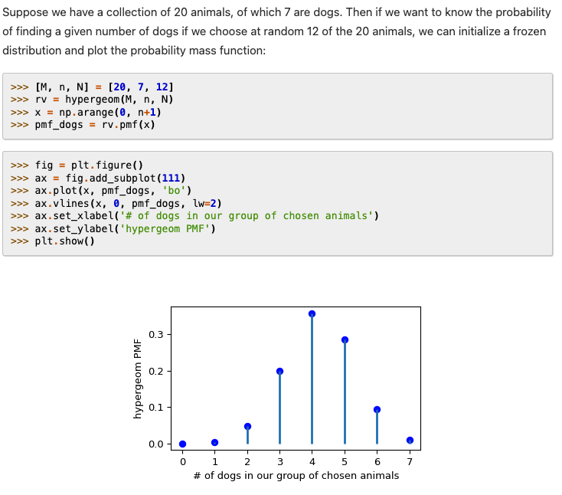
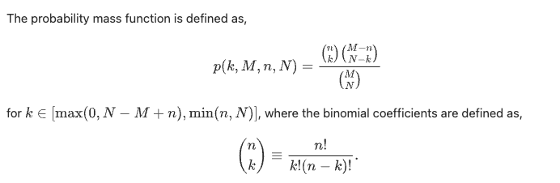
Gene set enrichment analysis
Gene set enrichment analysis (GSEA), sometime also called functional enrichment analysis or pathway enrichment analysis, is a method to identify classes of genes that are over-represented in a larger set of measured genes that may have an association to a specific biological phenotype
An array of statistical approaches, tools and packages have been developed to perform GSEA
Most of these are based on the hypergeometric test

Slide 29
Gene set enrichment analysis
Gene set enrichment analysis (GSEA), sometime also called functional enrichment analysis or pathway enrichment analysis, is a method to identify classes of genes that are over-represented in a larger set of measured genes that may have an association to a specific biological phenotype
An array of statistical approaches, tools and packages have been developed to perform GSEA
Some common packages include:
ClusterProfiler
A wide array of tools embedded in the package
https://bioconductor.org/packages/release/bioc/html/clusterProfiler.html
https://guangchuangyu.github.io/software/clusterProfiler/
PIANO
Combines several different approaches in a single analysis
https://varemo.github.io/piano/
DAVID

Slide 30
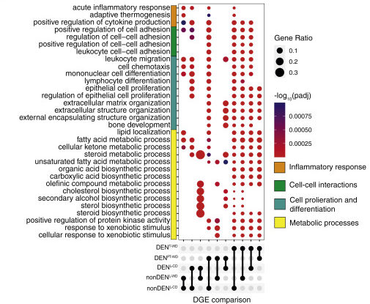
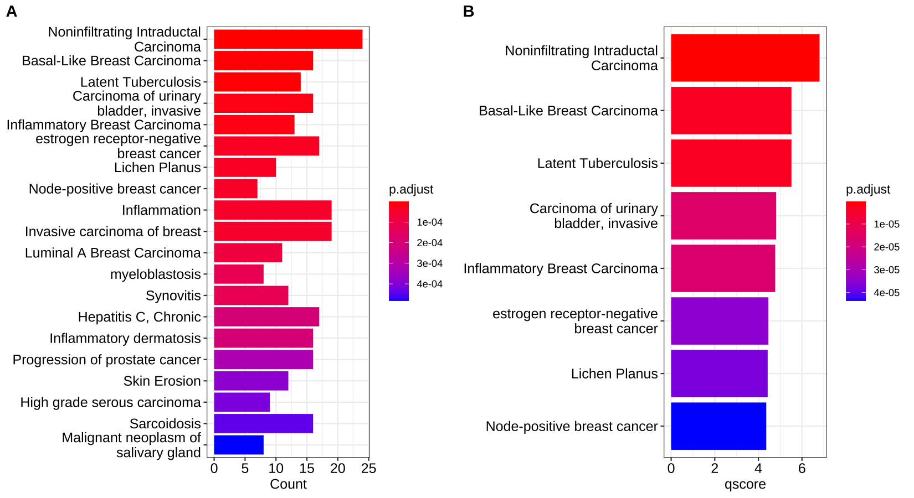
Gene set enrichment analysis

Slide 31
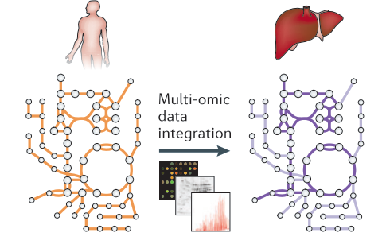
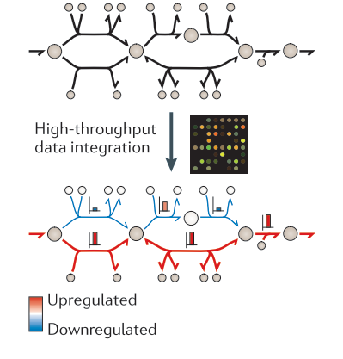

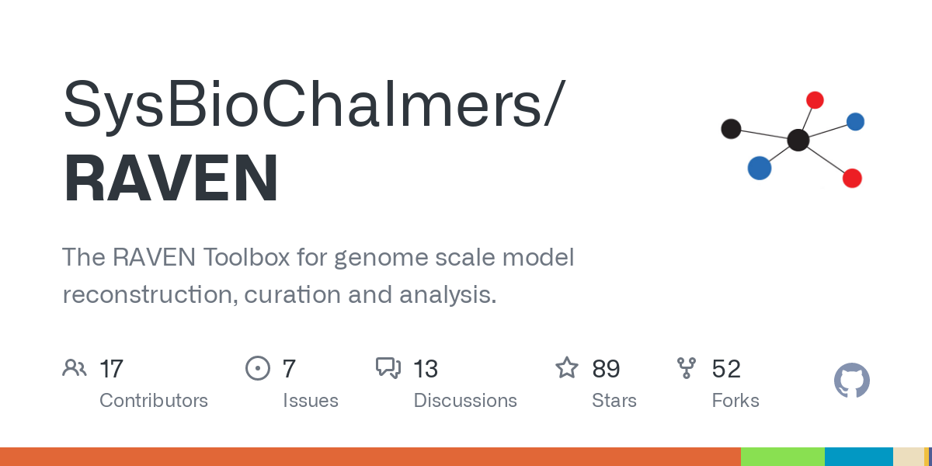
Data integration
Genome-scale metabolic models
Integrating transcriptomics data into GEMs does not only improve the accuracy of model predictions but also increase the interpretability of the data itself
Generation of cell- and tissue-specific GEMs from generic organism-level GEMs
Constraining GEMs to predict more accurate metabolic fluxes
Tools developed for this purpose

Slide 32
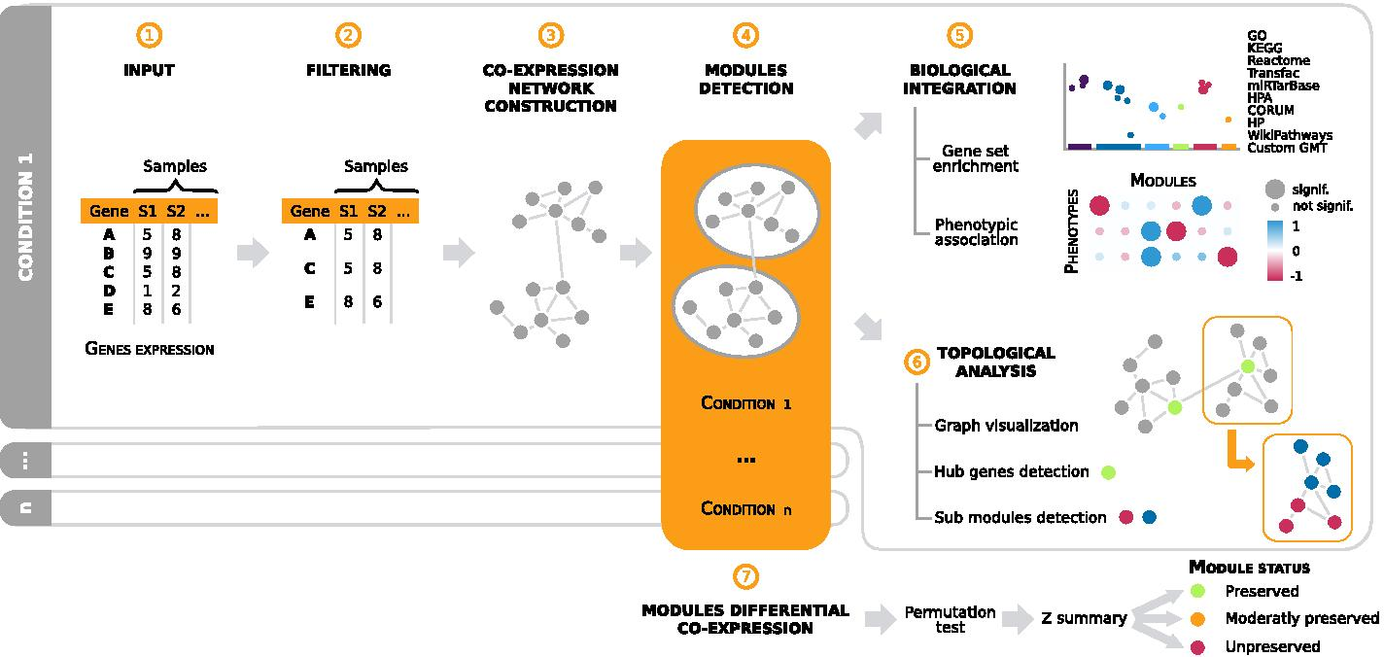
Data integration
Gene co-expression networks
https://bmcbioinformatics.biomedcentral.com/articles/10.1186/s12859-021-04179-4

Slide 33
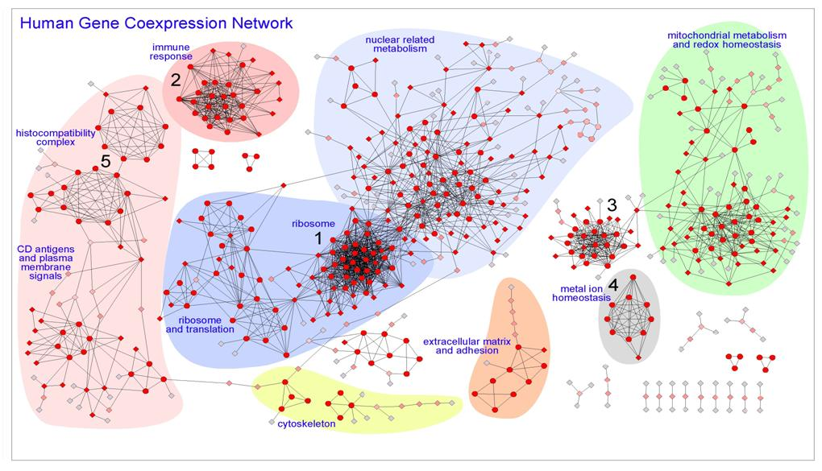
Data integration
Gene co-expression networks
There are several tools and pipelines that have been developed for detecting co-expression of genes
Most of these relies on the principle of correlation between genes to identify hubs of co-expressed genes
Example:
http://bioinfow.dep.usal.es/pages/coexpression/index.html

Slide 34
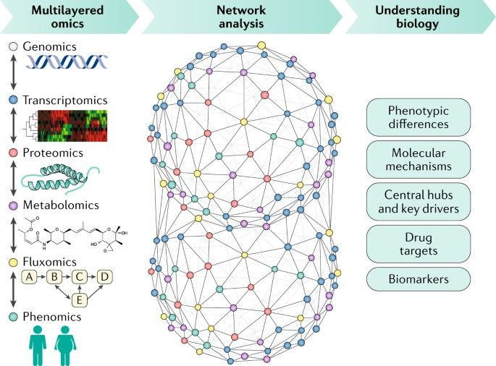
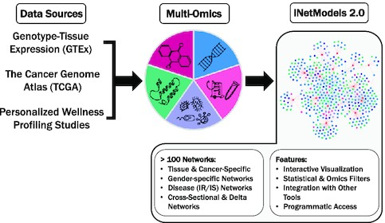
Data integration
Network analysis
Review paper on systems biology
https://www.nature.com/articles/s41575-018-0007-8
iNetModels – tool for network analysis
https://academic.oup.com/nar/article/49/W1/W271/6225230

